Slide 1
Bluesnarfing
One of many Bluetooth vulnerabilities
Kemi Adesoji & Darren DeChaine

Slide 2
What is Bluetooth?
Bluetooth is a short-range wireless technology standard that is used for exchanging data between fixed and mobile devices over short distances within UHF radio wave frequencies in the 2.4GHz range.
(wikipedia.org/wiki/bluetooth)
We were curious about the possibility of hacking into an old Nokia 2760 flip phone using a tactic called “bluesnarfing.”
The technology we worked with included: Kali Linux, Bluetooth Manager on Kali, hciconfig/hcitool (bluetooth interfaces on Kali,) btscanner, sdptool, bluesnarfer and Bluetooth from host PC made available to Kali machine.

Slide 3
Bluesnarfing
"Cybercriminals first look for devices with an active and discoverable Bluetooth connection. Then, they use a vulnerability scanning technique to identify blind spots on your phone's object exchange protocol to transmit data between your device and theirs." (https://www.makeuseof.com/what-is-vulnerability-scanning/)

Slide 4
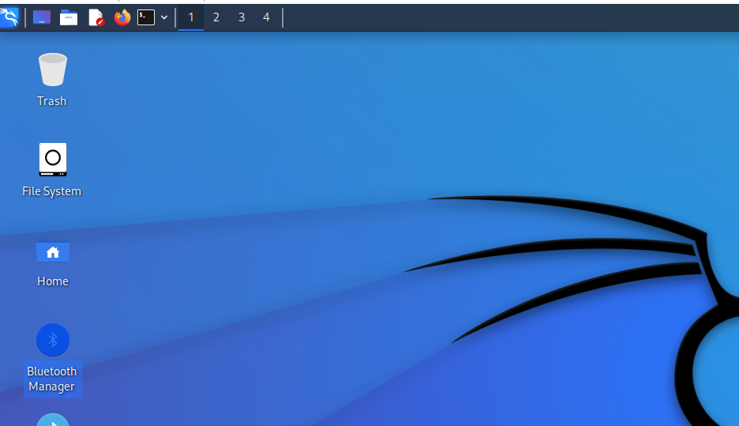
Bluetooth Manager (pre-installed on Kali)

Slide 5
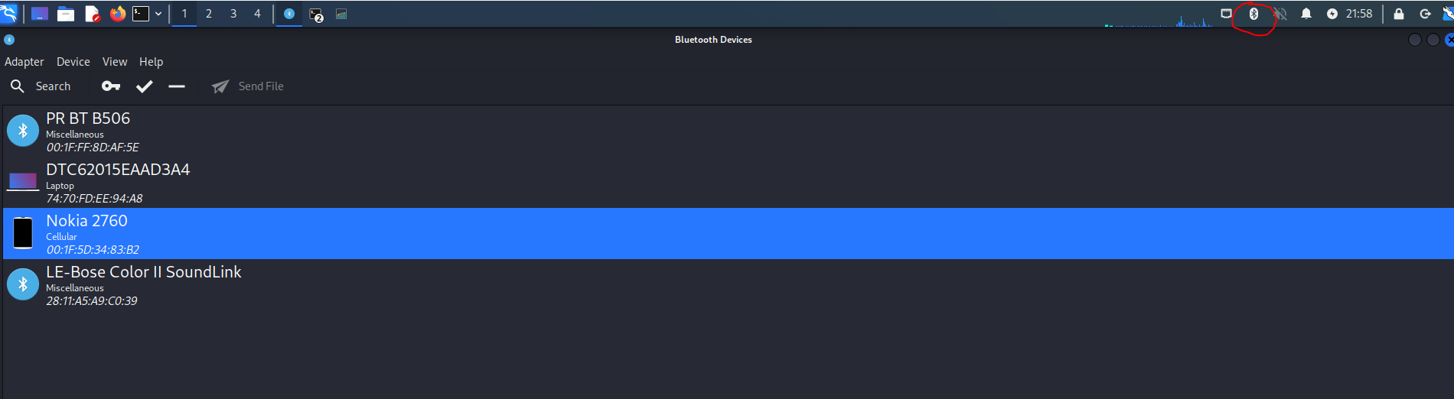
Scan for bluetooth devices with Bluetooth Manager on Kali

Slide 6
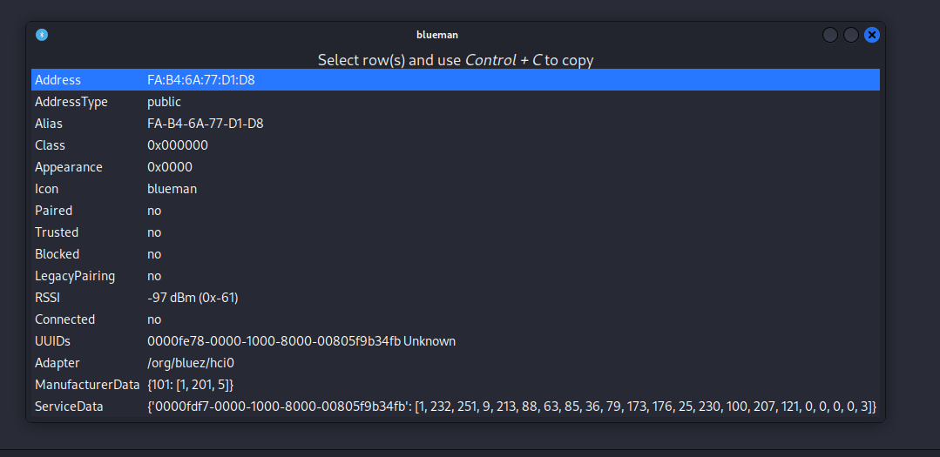
Right click to view device info:

Slide 7
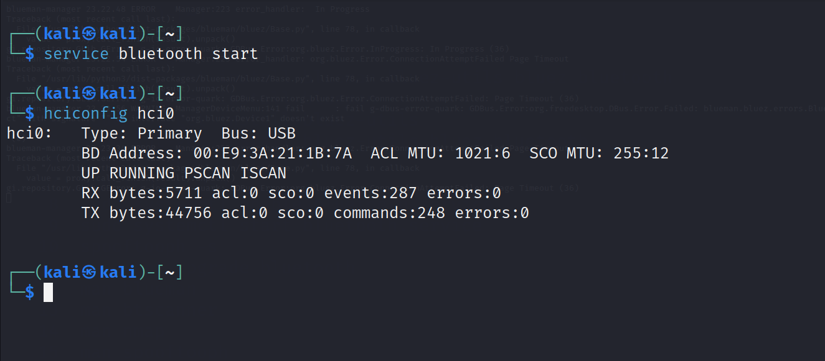
Start Bluetooth and verify running: (https://www.offensive-wireless.com/how-to-bluesnarf-devices/)

Slide 8
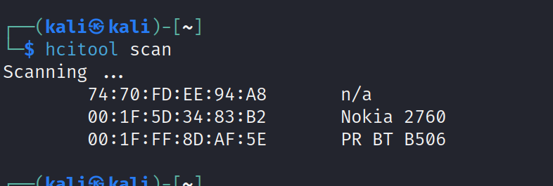
Verify Discoverability & gain unique MAC (media access control) address (https://www.offensive-wireless.com/how-to-bluesnarf-devices/)

Slide 9
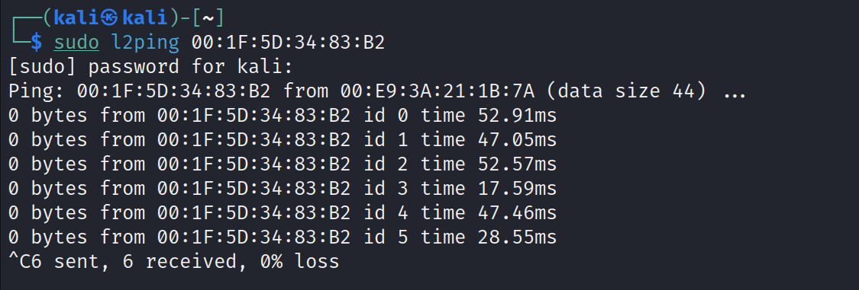
Ping Device: (https://www.offensive-wireless.com/how-to-bluesnarf-devices/)

Slide 10
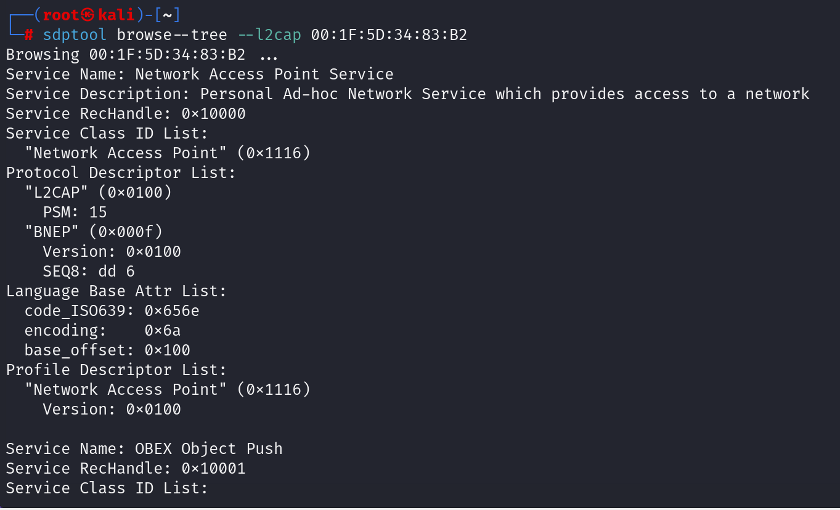
Even more info with sdptool: (https://www.offensive-wireless.com/how-to-bluesnarf-devices/)

Slide 11
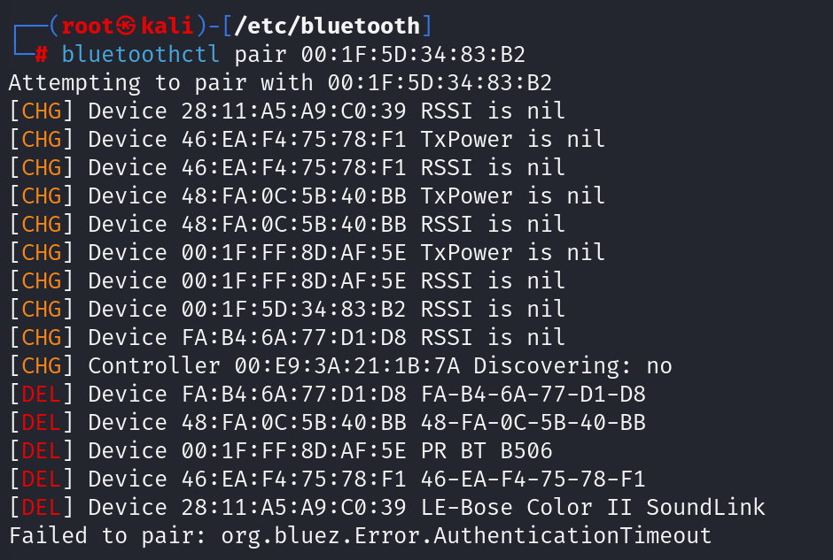
Pairing fails: (https://www.offensive-wireless.com/how-to-bluesnarf-devices/)

Slide 12
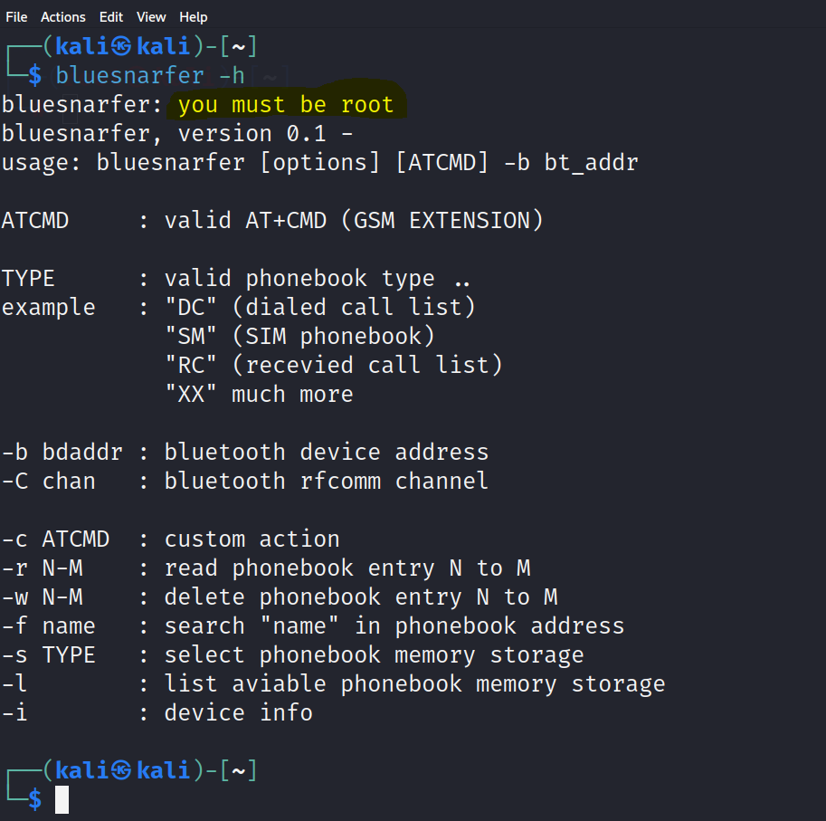
Bluesnarfer must be root: (Admin-level privileges but shows options - showing next steps if pair successful.)

Slide 13
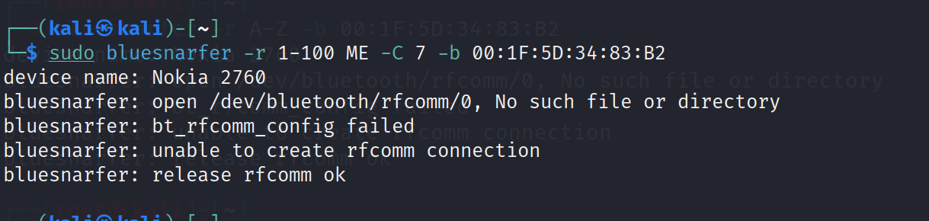
Run bluesnarfer: (https://www.offensive-wireless.com/how-to-bluesnarf-devices/)

Slide 14
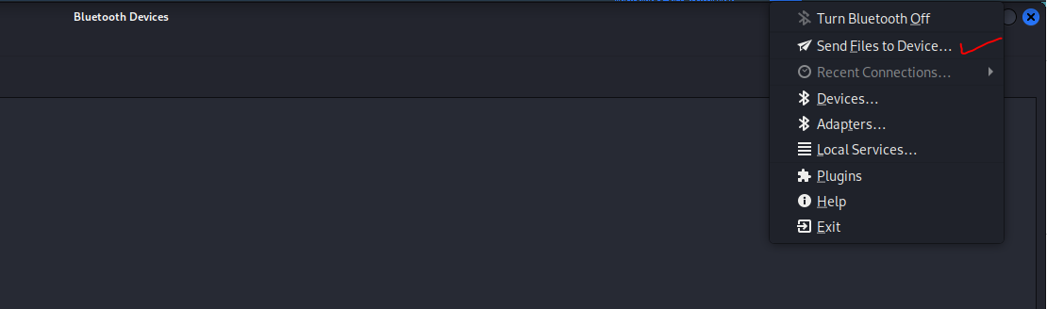
Now, try to send a file to device:

Slide 15
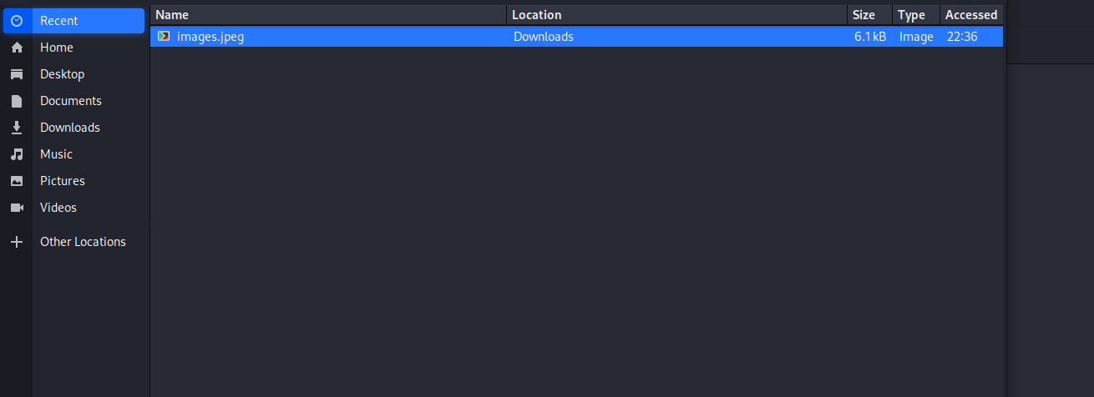
Select the file:

Slide 16
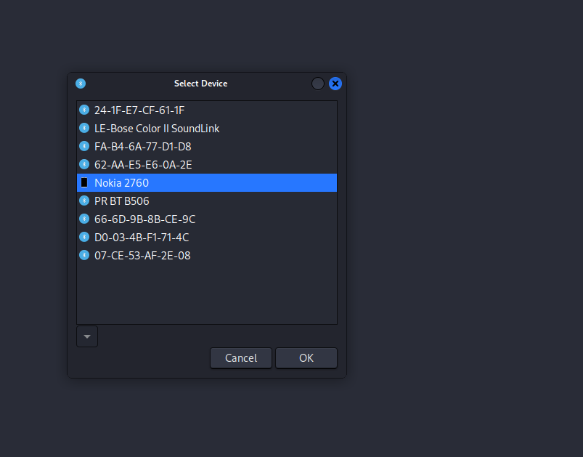
Select the device:

Slide 17

Sends image (device asks to verify)

Slide 18
Summary
While we weren’t able to hack into the old Nokia flip-phone, this process really helped us understand the concepts and potential vulnerabilities surrounding bluetooth. Imagine if the image contained malware and the user accepted this file.
Steps to consider for preventing bluetooth attacks like bluesnarfing:
Turn bluetooth and device discoverable off.
Do not accept pairing requests unknown to you.
Keep your device’s software up to date.
Avoid connecting a device for the first time in public.

Slide 19
Thanks for watching!
Congratulations to everyone for making it to the end. Good luck!
-Kemi & Darren

